Slide 1

CREDIT SCORE V. FICO SCORE (FAIR ISAAC CORPORATION)
WHAT DO YOU REALLY NEED TO KNOW!
DR. ERIC TERRY

Slide 2
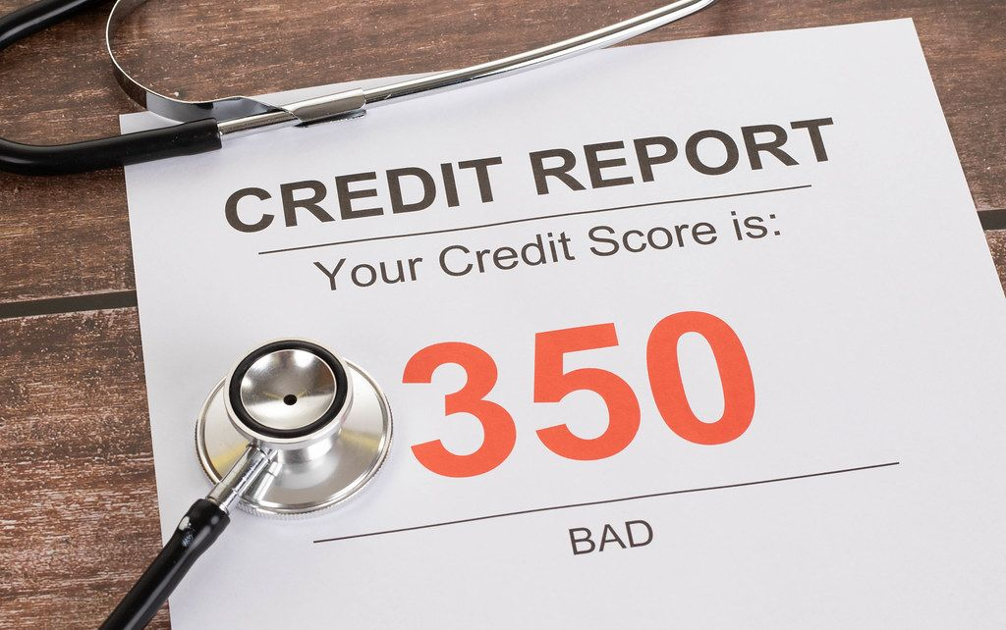
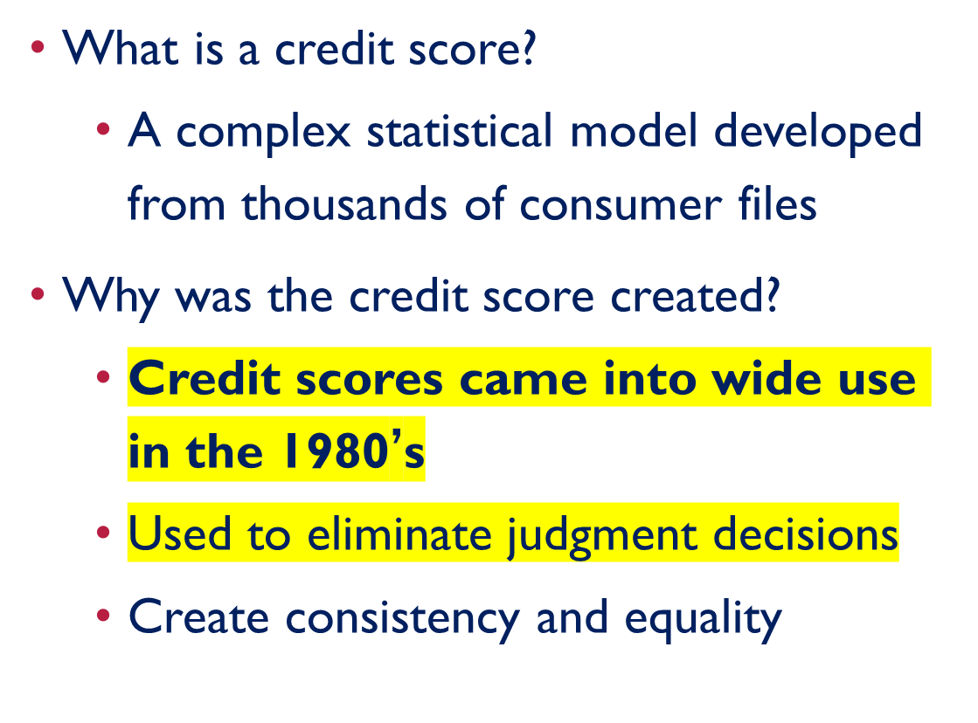
YOUR CREDIT - FICO SCORE
This Photo by Unknown Author is licensed under CC BY

Slide 3
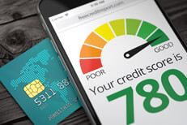
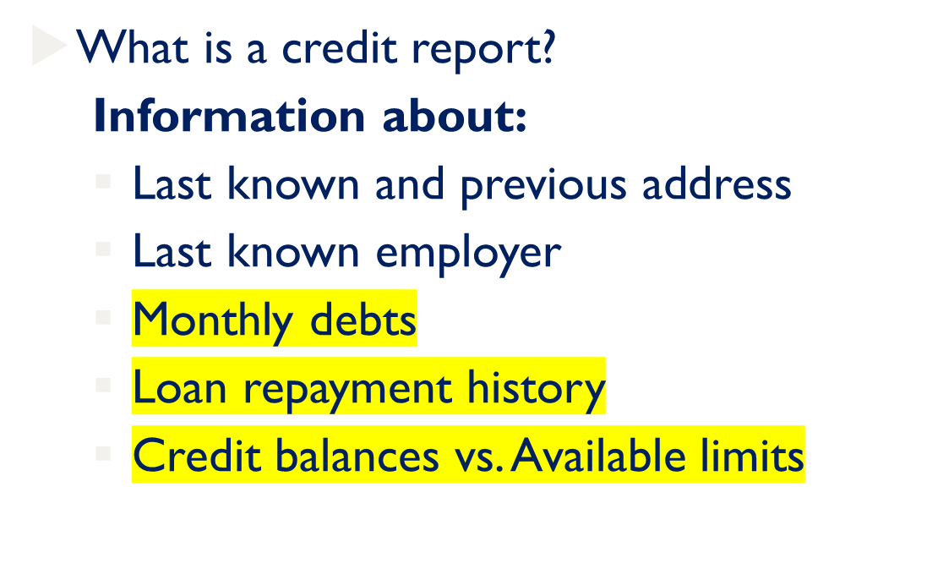
THE BASICS

Slide 4
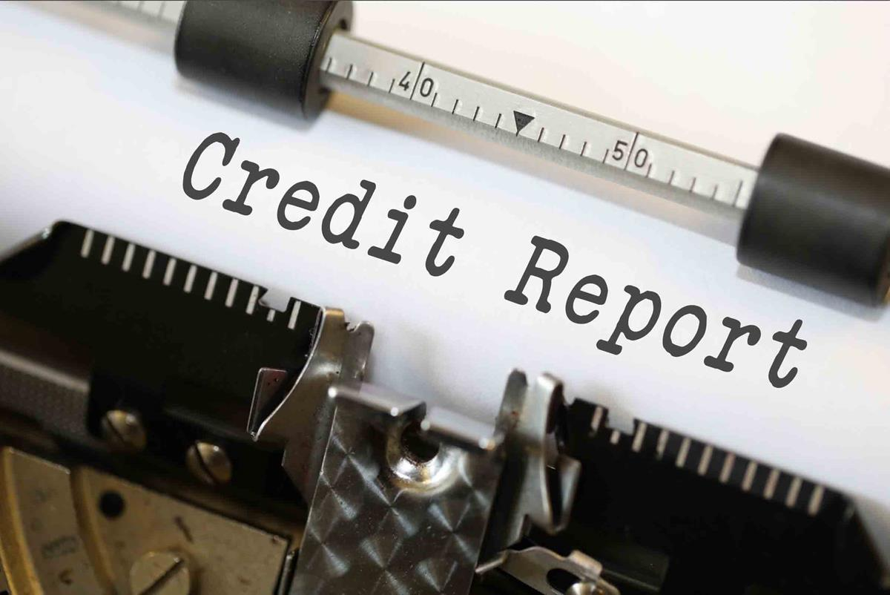
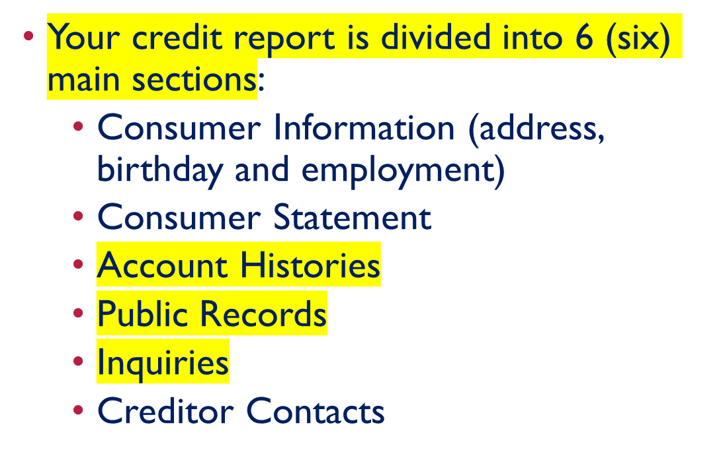
YOUR CREDIT REPORT
Notes:
When you open a new account, miss a payment or move, these sections are updated with new information. Old negative records will stay on your credit report for 7-10 years. Positive records can remain on your credit report longer. Not all creditors report to all three agencies and the agencies obtain their data independently so your reports from the three CRA’s could be substantially different from the others.

Slide 5
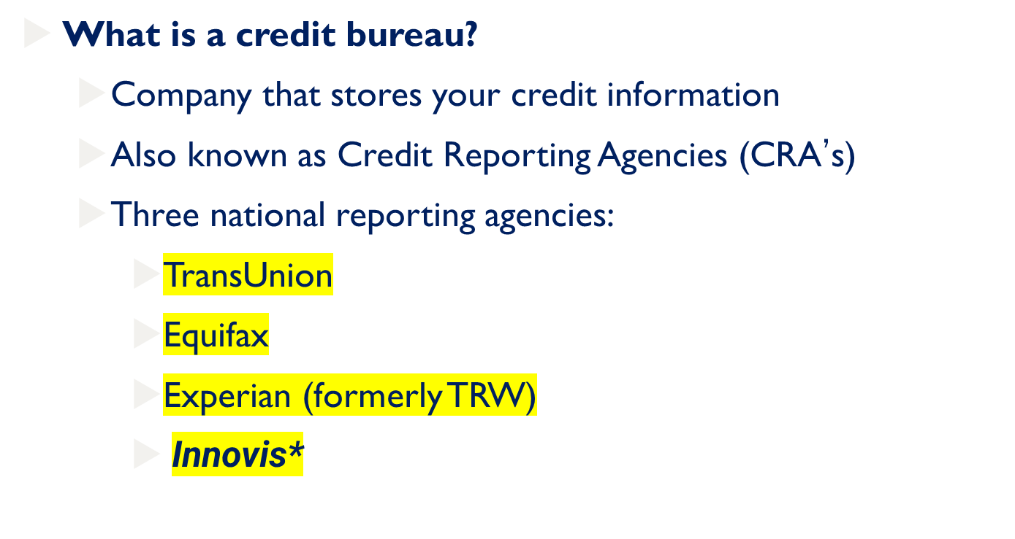
THE BASICS

Slide 6
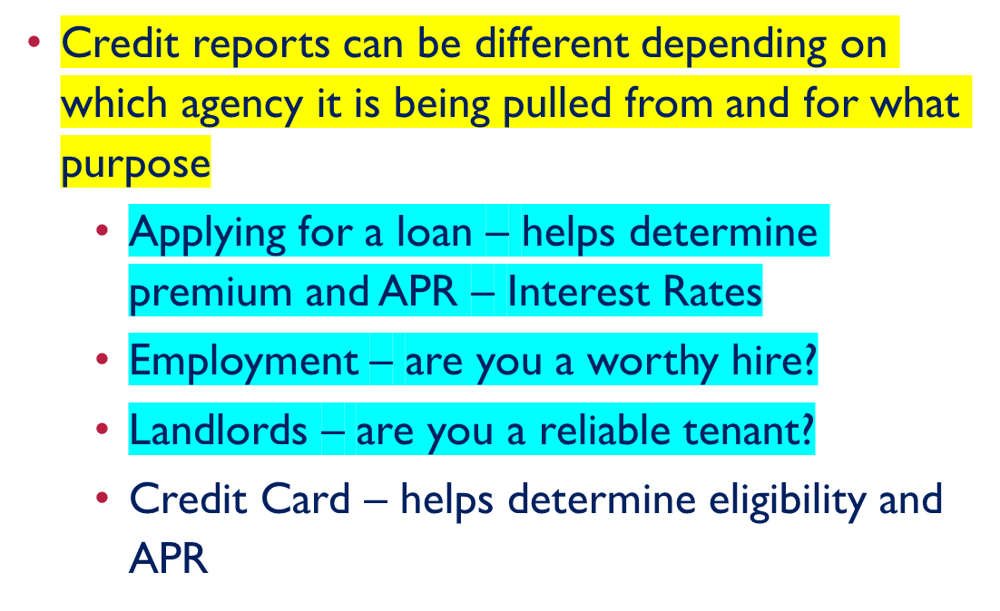

THE BASICS

Slide 7

THE FACT ACT
Stands for Fair and Accurate Credit and Transactions (FACT) Act
The FACT Act was signed into law December 2003

Slide 8
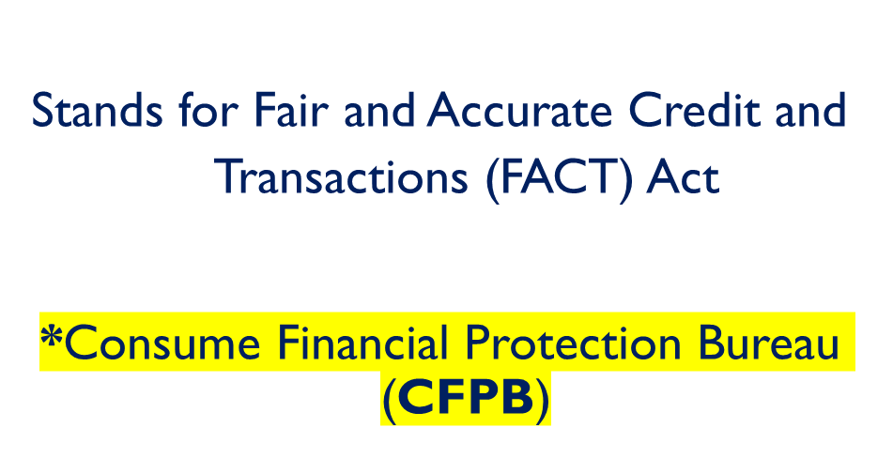

THE FACT ACT

Slide 9
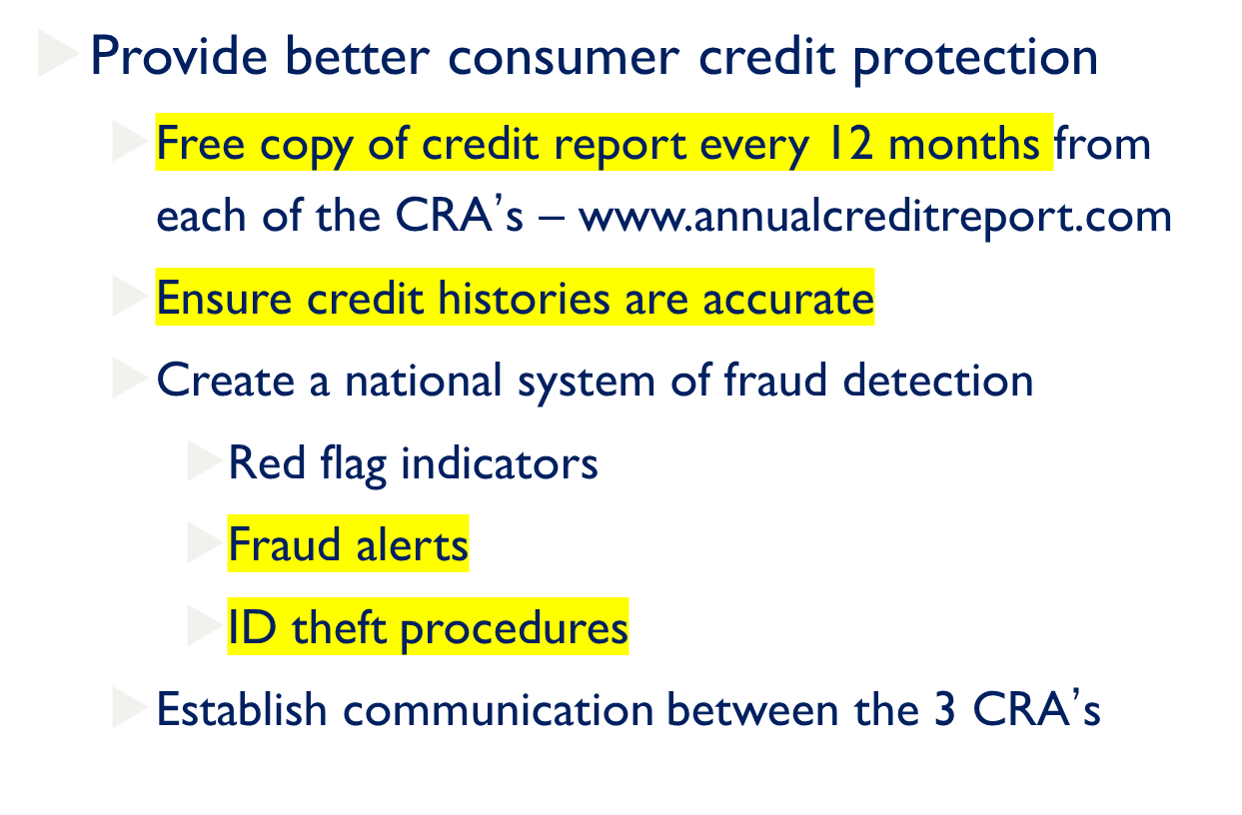

THE FACT ACT

Slide 10
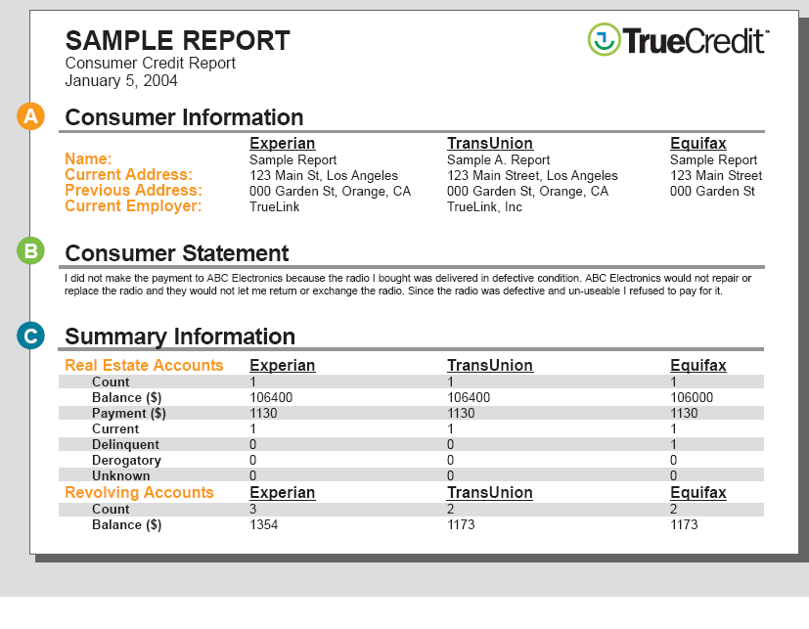

Slide 11
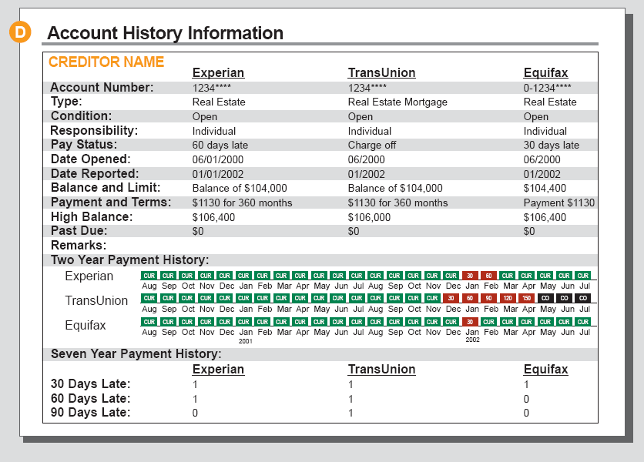

Slide 12
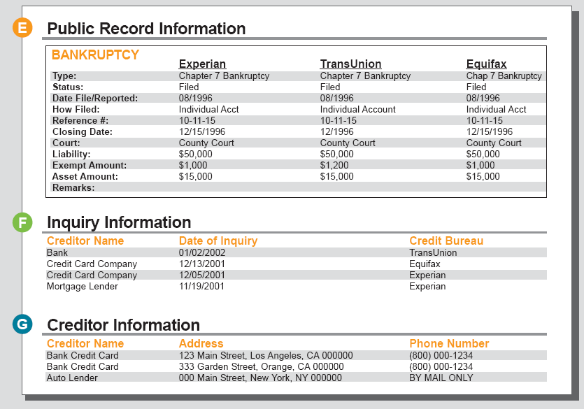

Slide 13
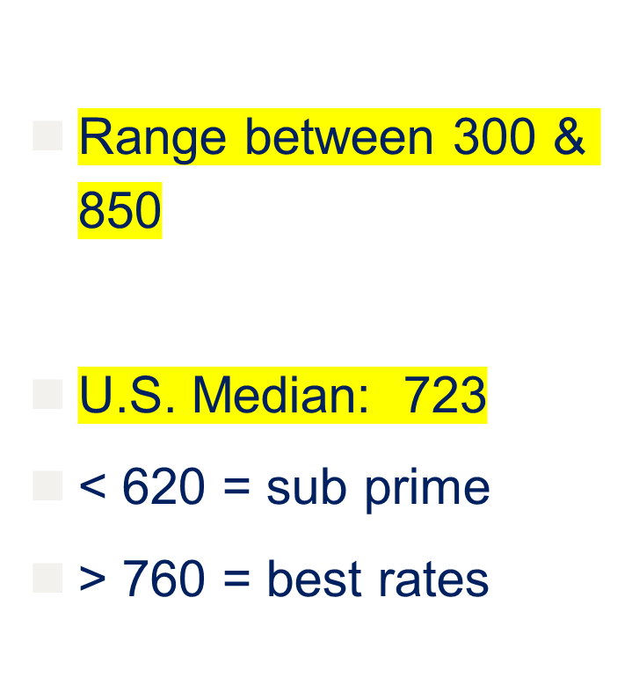
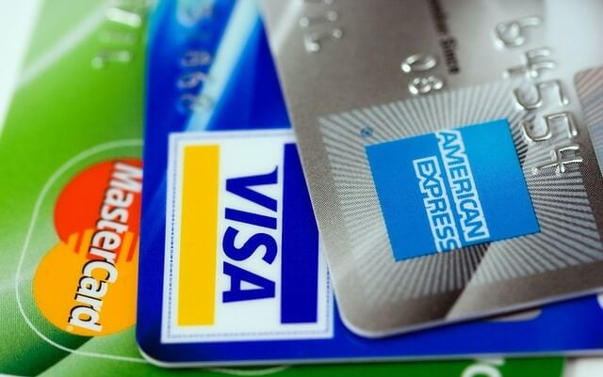
FICO SCORE
Notes:
Credit Score: A number, roughly between 300 and 850, that reflects the credit history detailed by a person's credit report.
The Fair Isaac Company is the organization that computes credit scores for the three credit bureaus: TransUnion, Experian, and Equifax.
_____________________________________________________________________________________________________________________
Credit scores change constantly, so one peek won't do much good. Scores are built on the information in your credit reports, which does indeed change all the time. Pay down a credit card balance and your score goes up; apply for a new account and your score goes down. But most peoples' FICO scores are relatively stable, changing less than 20 points in any three-month period, so an annual look would at least help people understand their credit ballpark.
Source: Pulliam-Weston, Liz, “Demand Your FICO Score Now!,” MSN Money, October 9, 2006.

Slide 14
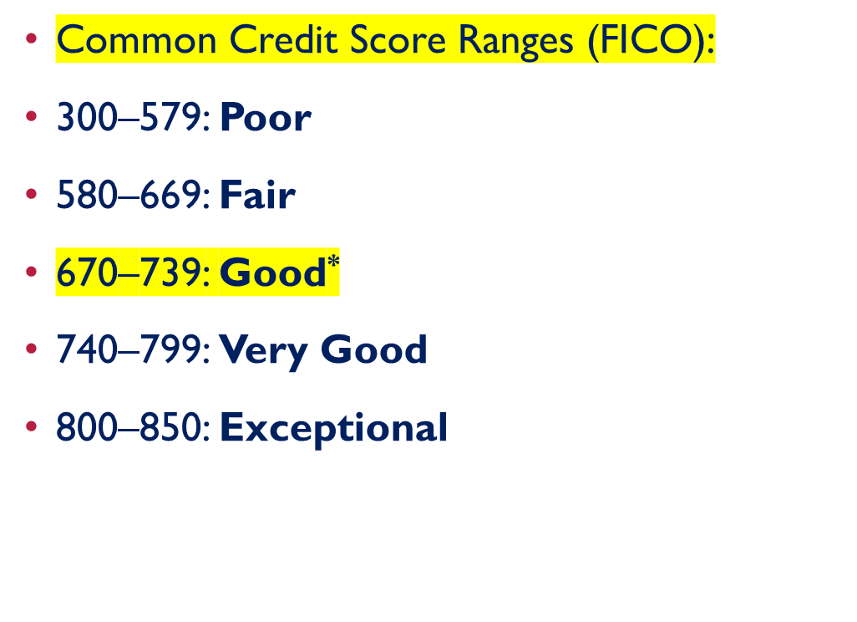
FICO SCORE
Notes:
Credit Score: A number, roughly between 300 and 850, that reflects the credit history detailed by a person's credit report.
The Fair Isaac Company is the organization that computes credit scores for the three credit bureaus: TransUnion, Experian, and Equifax.
_____________________________________________________________________________________________________________________
Credit scores change constantly, so one peek won't do much good. Scores are built on the information in your credit reports, which does indeed change all the time. Pay down a credit card balance and your score goes up; apply for a new account and your score goes down. But most peoples' FICO scores are relatively stable, changing less than 20 points in any three-month period, so an annual look would at least help people understand their credit ballpark.
Source: Pulliam-Weston, Liz, “Demand Your FICO Score Now!,” MSN Money, October 9, 2006.

Slide 15
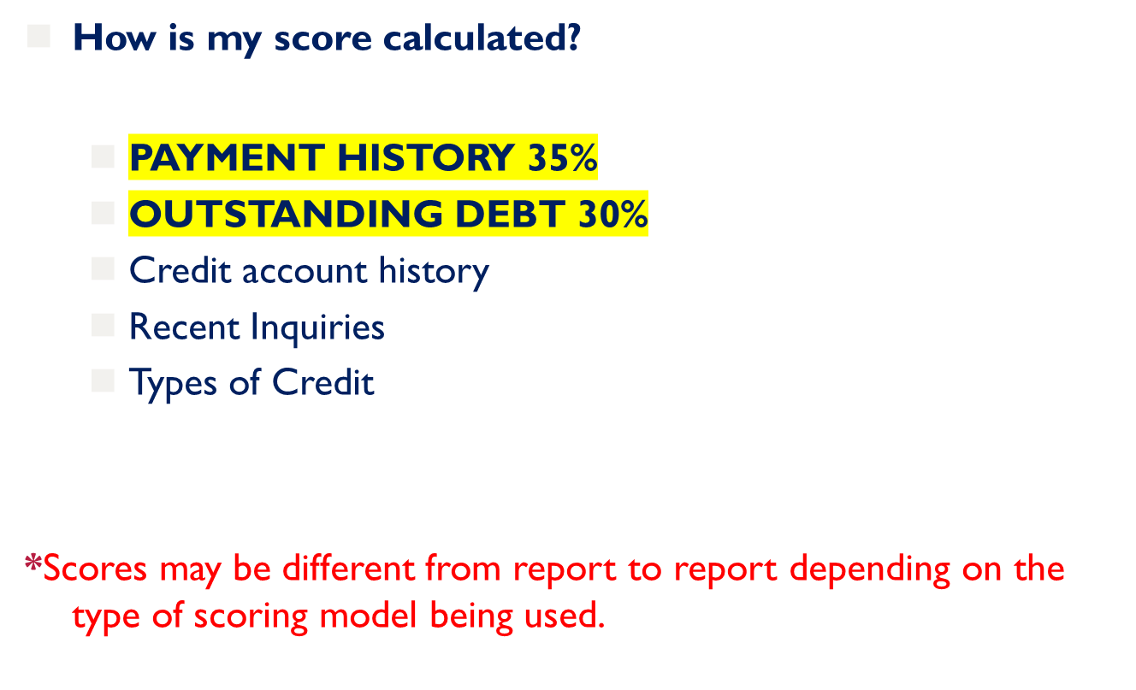
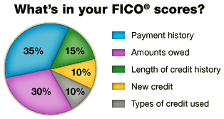
YOUR FICO SCORE

Slide 16

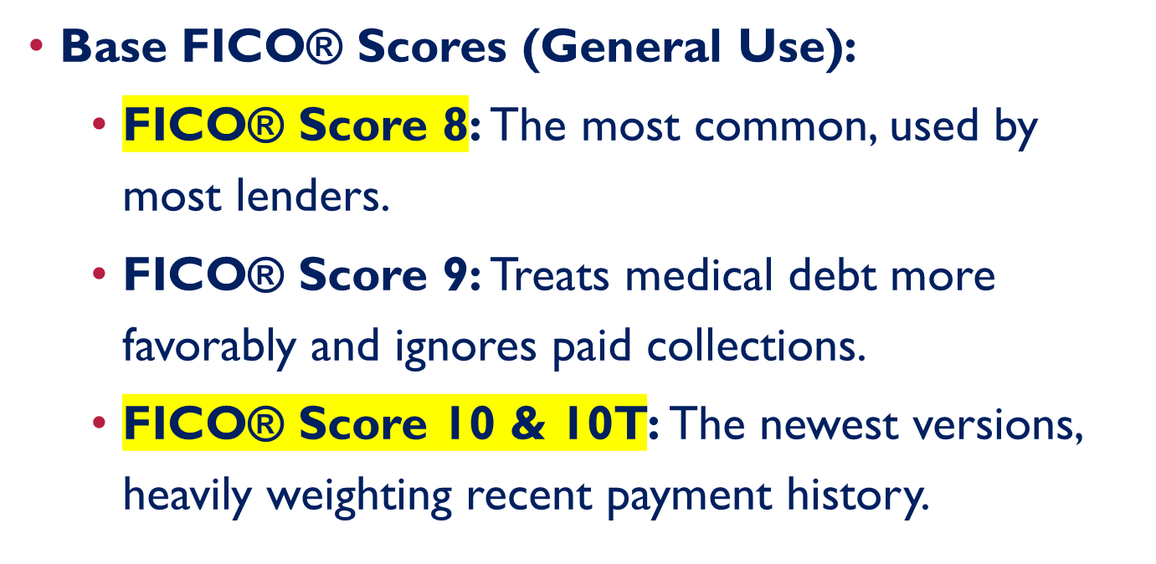

Slide 17
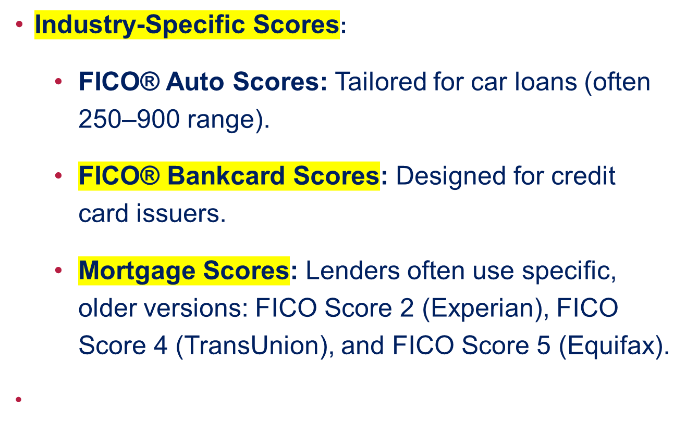
YOUR FICO SCORE

Slide 18
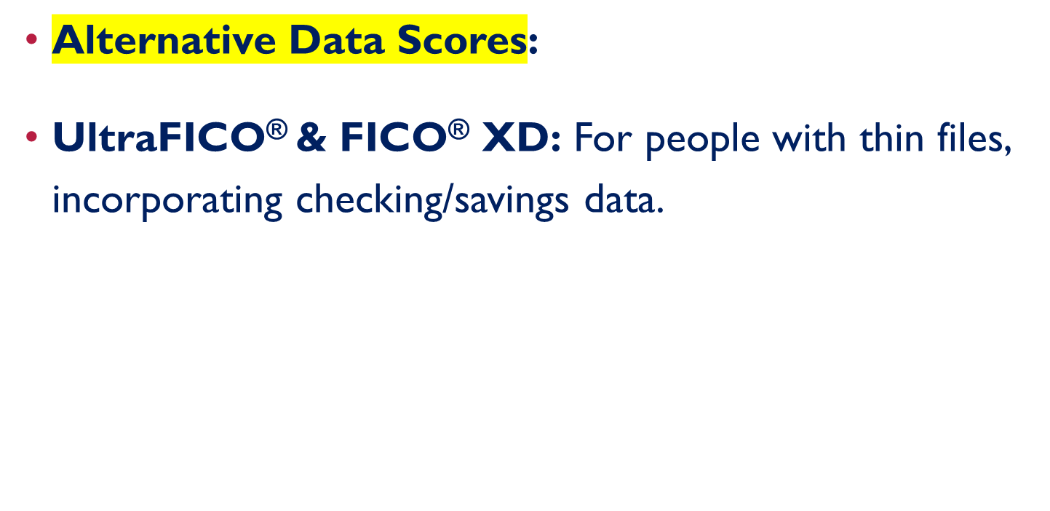

YOUR FICO SCORE

Slide 19

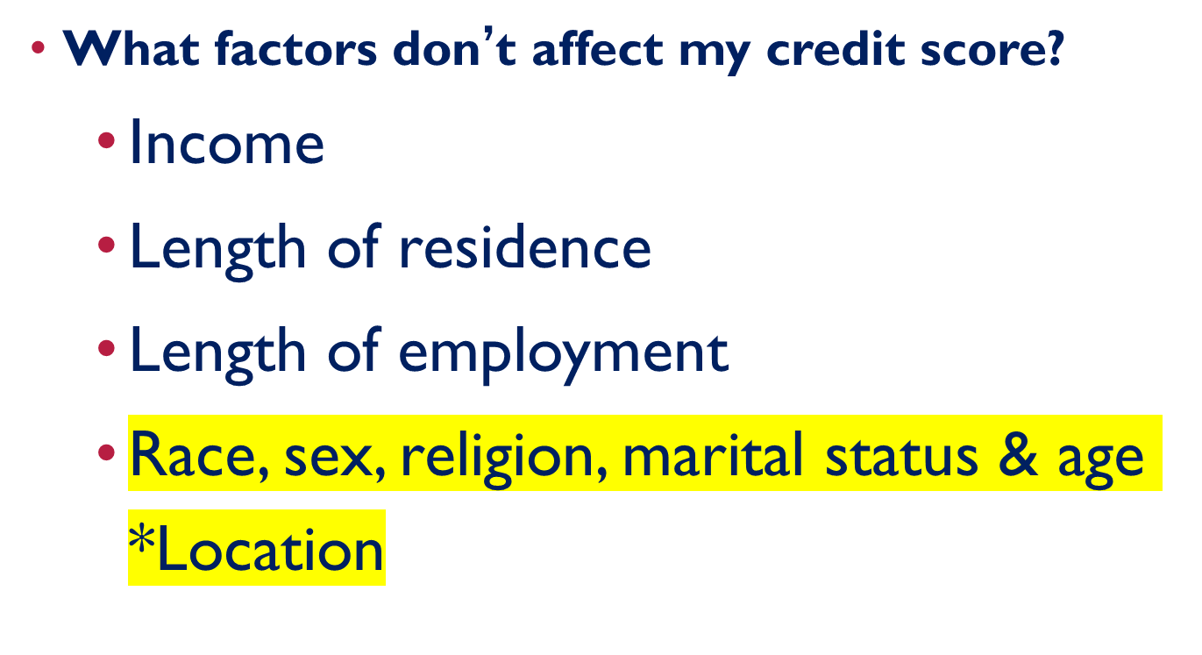
YOUR FICO SCORE

Slide 20

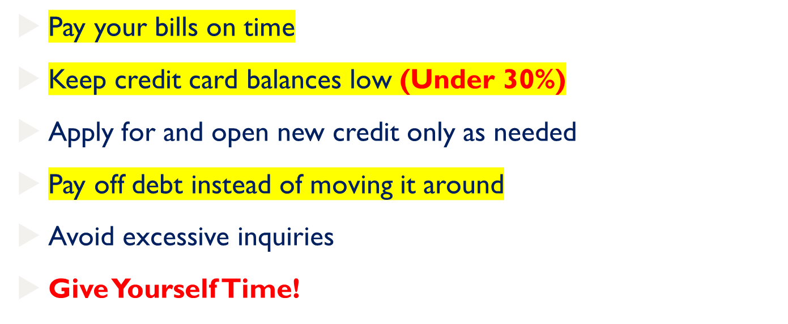

Notes:
Keep your credit card balances (or revolving debt) below 35% of the available limit.
Don’t open up new credit to try and raise your score, it probably won’t raise your score.
Don’t close unused cards as a short-term strategy to raise your score. Owing the same amount but having fewer open accounts may lower your score.
A large number of inquires over a short period my signal to a lender that your are opening numerous credit accounts due to financial difficulties or overextending yourself.
Time is one of the most significant factors that can improve your credit score.

Slide 21
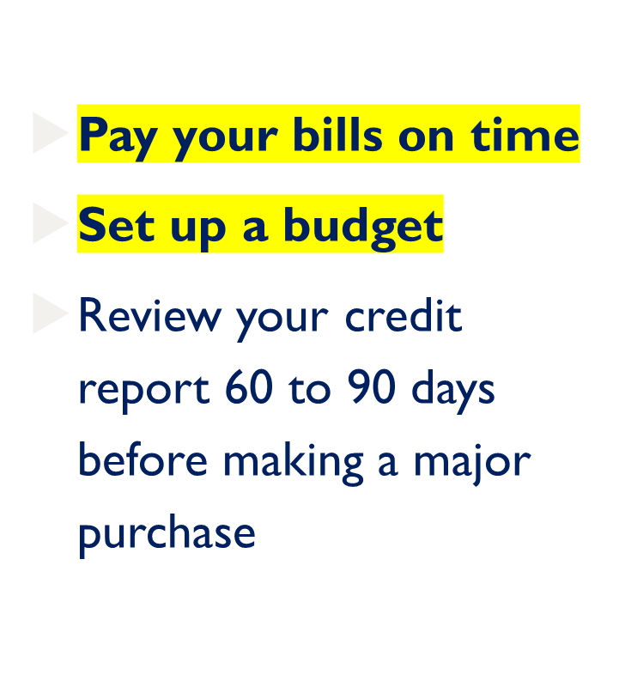

CREATE A POSITIVE HISTORY

Slide 22

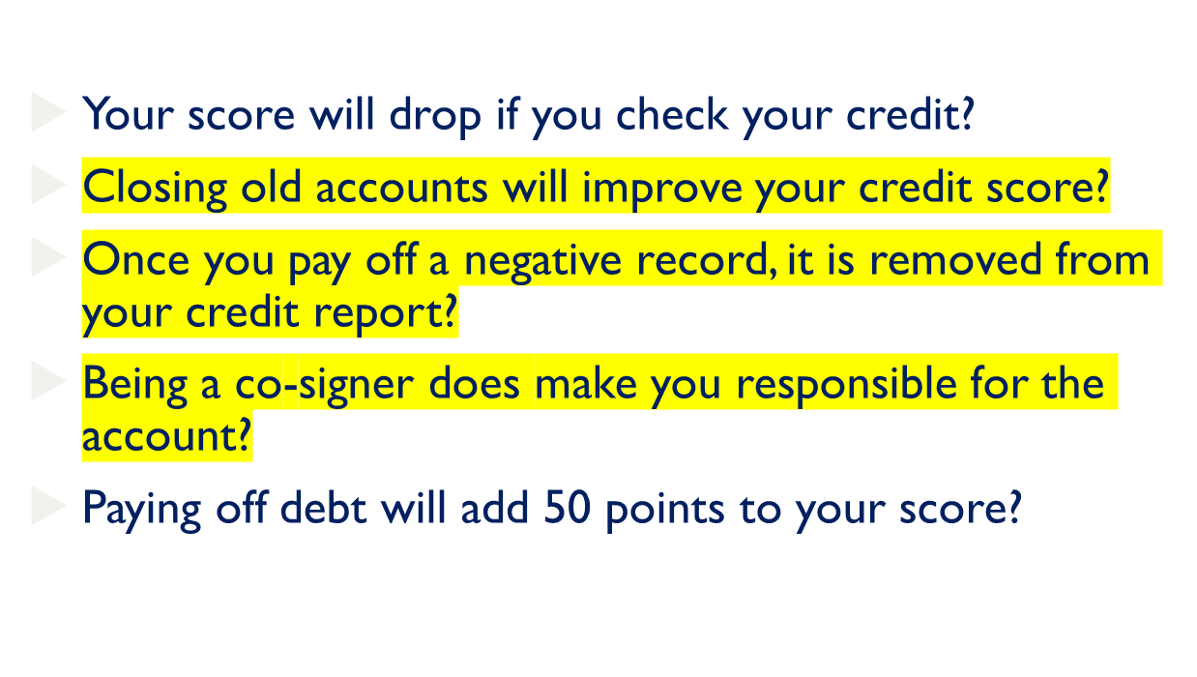
CREDIT MISCONCEPTIONS - QUESTIONS
Notes:
Not true – Checking your won report and score is counted as a “soft inquiry” and doesn’t harm your credit at all. Only “hard inquiries” from a lender or creditor, made when you apply for credit, can bring your score down.
Canceling old credit accounts can lower your credit score by making your credit history appear shorter.
Negative records such as collection accounts, bankruptcies and late payments will remain on your credit report for 7-10 years. Try to pay off collection items in full instead of settling if at all possible
When you open a joint account, co-sign or become an authorized user on someone’s card, you are taking on a legal responsibility for the account. Any activity, good or bad, will show up on your report.
Your credit score is a complex algorithm that takes into account hundreds of factors and values. It is very hard to predict how many points one factor will affect your score.

Slide 23
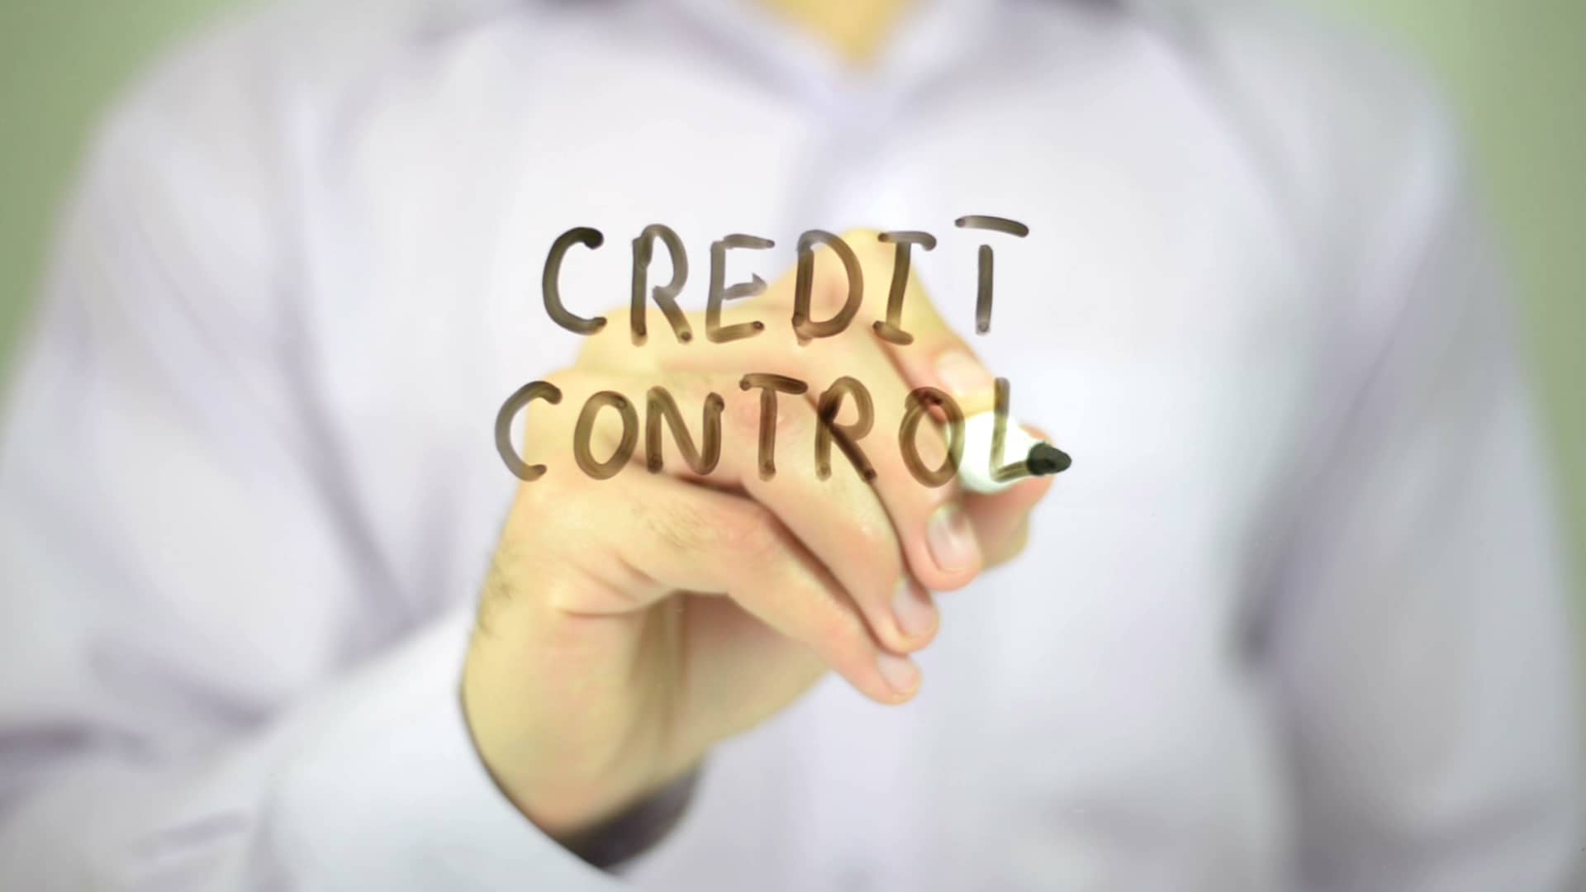
TAKE CONTROL OF YOUR CREDIT
QUESTIONS?

